Slide 1
Assignment 6 Workshop
Fall 2020 Learning Assistants

Slide 2
Agenda
Git objects
zlib
Graphs and topological sorting
Q&A if there’s time

Slide 3
Git objects
How does a Git repository store information about files? How does it store information about commits?

Slide 4
Git objects
Git stores this information in Git objects.
Git objects consist of data and a hash (used to identify the object).
Git is a big dictionary where:
The keys are hashes.
The values are Git objects.
These objects are stored in .git/objects.

Slide 5
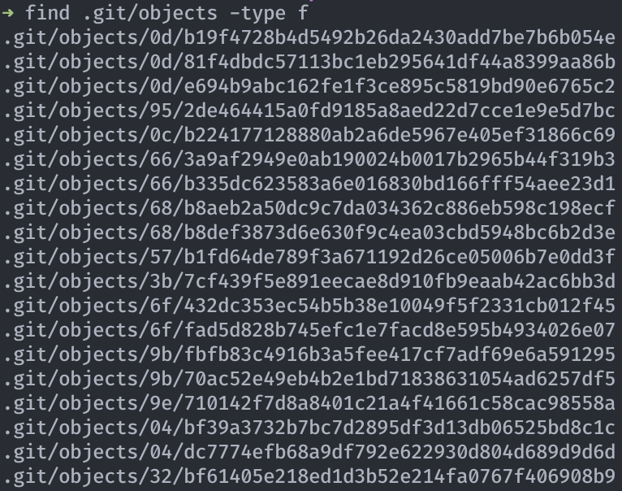
Git objects
Here’s what this “dictionary” looks like:
The hash of each Git object is the name of the folder + the name of the file.
The data stored by that Git object is the contents of the file.

Slide 6
Git objects
There are three main types of Git objects.
Blob objects are used to store the contents of a file.
Tree objects represent directories. They can reference other trees (subdirectories) or blobs (files).
Commit objects contain
A tree object that determines the current state of the repository.
The hash of the parent commit(s).
When can a commit have multiple parents? When can it have none?

Slide 7
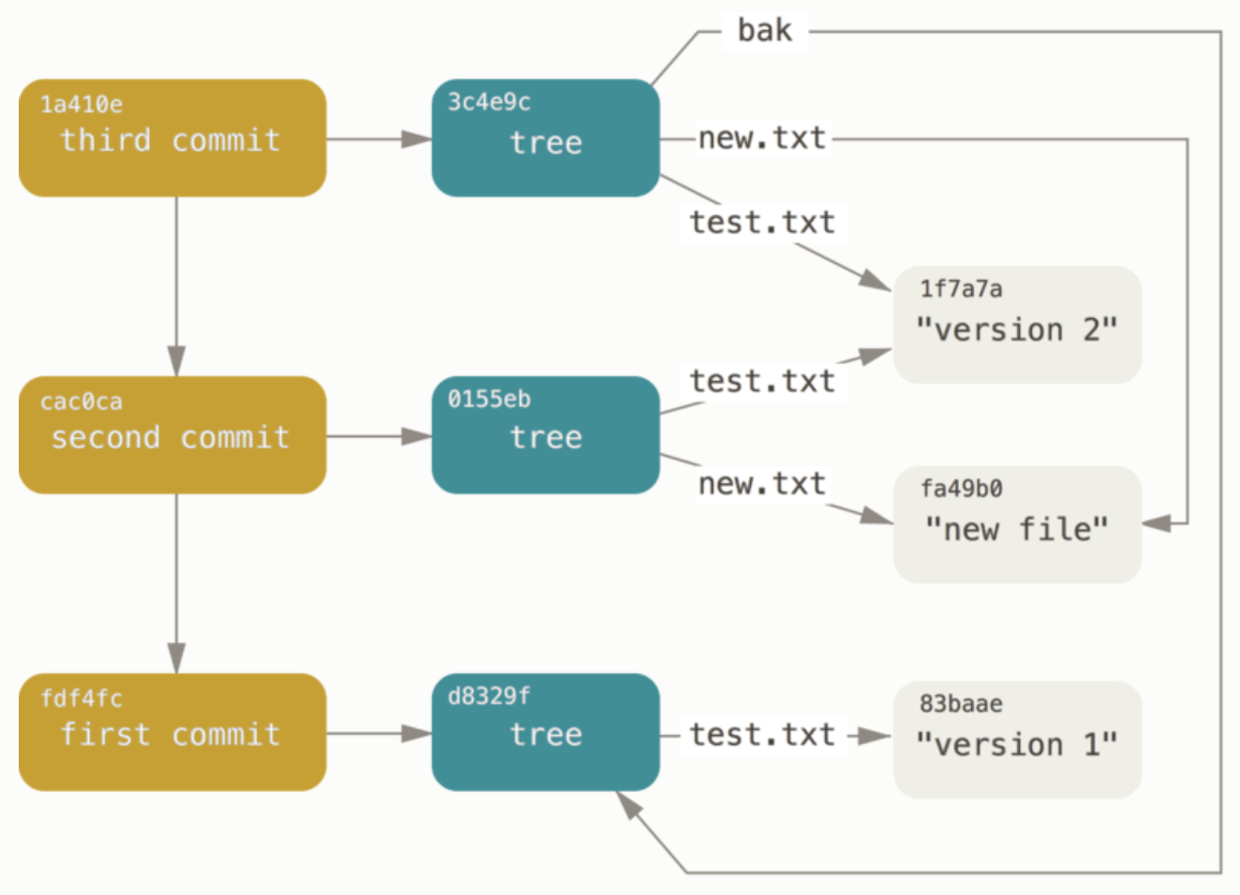
Git objects
What is the state of this repository after the second commit?
What about the way Git stores information makes it efficient?

Slide 8
Git objects
A file storing a commit object might look like (after you decompress it):
$ git cat-file -p <commit_hash>
tree d8329fc1cc938780ffdd9f94e0d364e0ea74f579
parent 1a860ce82e3c287bf2c04f2653c0fc9ce3bc93a2
author Scott Chacon <schacon@gmail.com> 1243040974 -0700
committer Scott Chacon <schacon@gmail.com> 1243040974 -0700
Second commit
What’s the commit hash of the commit that came before this commit?

Slide 9
Git objects
One problem: If Git simply stores all objects in a big directory, how do you know where the “current commit” is?
Git references are pointers to Git objects.
Git references allow us to use branches. A branch is simply just a Git reference that points to the HEAD of that branch.

Slide 10
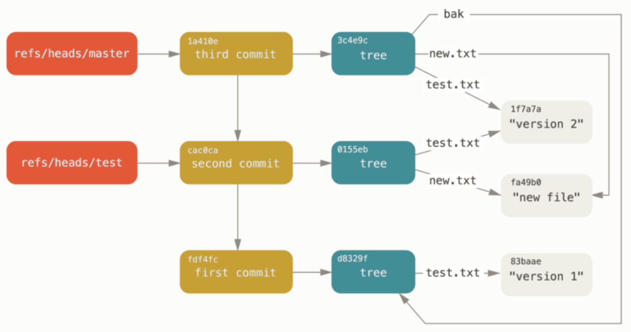
Git objects
What is the difference between the test and master branches?

Slide 11
zlib
zlib is a library for compressing and decompressing data.
Why does Git use zlib?

Slide 12
zlib
To use zlib, just import zlib in Python.
Function signature of zlib.decompress:
zlib.decompress(data, wbits=MAX_WBITS,
bufsize=DEF_BUF_SIZE)
data is the data you want to decompress, as a bytes object.
wbits and bufsize are implementation details. The defaults are fine.

Slide 13
zlib
To decompress the contents of a file:
file = open('compressed_file', 'rb')
compressed_data = file.read()
decompressed_data = zlib.decompress(compressed_data)
Note that the 'b' when opening the file is important! This reads the data in as bytes rather than a string.
One of the best ways to navigate the .git directory in Python is to use pathlib.

Slide 14
Graphs and Topological Sorting
See week 7 LA worksheet

Slide 15
Q & A

